Slide 1
Unit 1 Living Systems Do Now

Slide 2
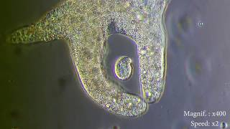
Do Now
1) How many living things are interacting in this video? How do you know?
2) How is the larger living thing getting what it needs from its environment? What other inputs and outputs are not shown in the video?

Slide 3
Do Now
Classify a cell as either prokaryotic or eukaryotic based on its characteristics. What features helped you make this classification?
Define homeostasis and provide one example

